Slide 1

Marriages in maine
Data, Research, and Vital Statistics
Rebecca Ashley, Vital Records Representative (marriages)
Merton Brown, Municipal Clerk of Kennebunk

Slide 2

Registration of Marriages marriage section, page 6
Marriage registration includes several steps:
filing intentions,
issuing the marriage license, and
filing the marriage certificate after the ceremony has been performed.
There are several situations in which additional documents are required.
The Department provides information and forms related to marriage for the public on DRVS website at:
https://www.maine.gov/dhhs/mecdc/public-health-systems/data-research/vital-records/forms/index.shtml
Notes:
Talk about the fetal alcohol pamphlet here and where to find it.

Slide 3
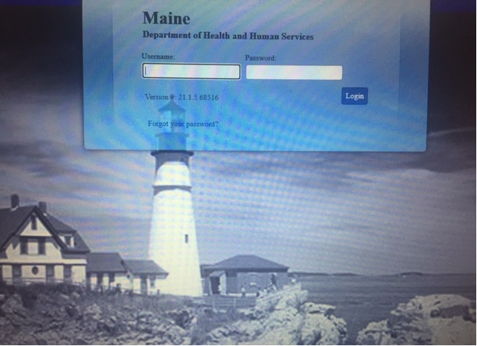


Electronic marriage registration system
(emrs) marriage section, page 6
http://www.mainelegislature.org/legis/statutes/22/title22sec2702-B.html
Notes:
The EMRS is one of the modules in the DAVE system and contains marriage records from 2017 to present. When parties get married in the State of Maine, regardless of their gender, the marriage certificate must be filed and registered in the Electronic Marriage Registration System (EMRS) maintained by the State Registrar of Vital Statistics. Municipal clerks who do not have access to the EMRS should contact the Department to obtain a username and password to access the system and available training options. Please contact the helpdesk by calling (207) 287-5447 or via e-mail at EDRS.DHHS@maine.gov.

Slide 4
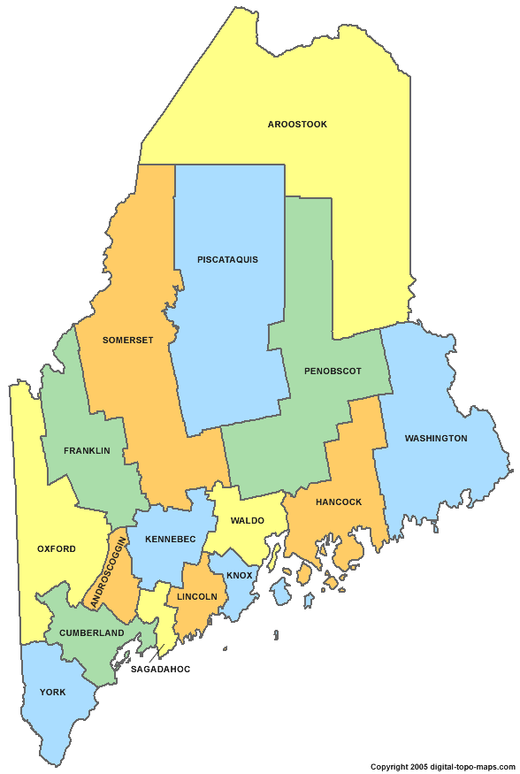


Recording the marriage intentions marriage section, page 6
Maine Residents
Out of State Residents
No clerk?
Must file their intentions in the municipality in which at least one of them resides or with the Department.
May file in any municipality or with the Department.
(We recommend to file with the place of marriage municipality).
If there is no clerk in the place of their residence, the intentions must be filed with the clerk of an adjoining municipality or with the Department.

Slide 5
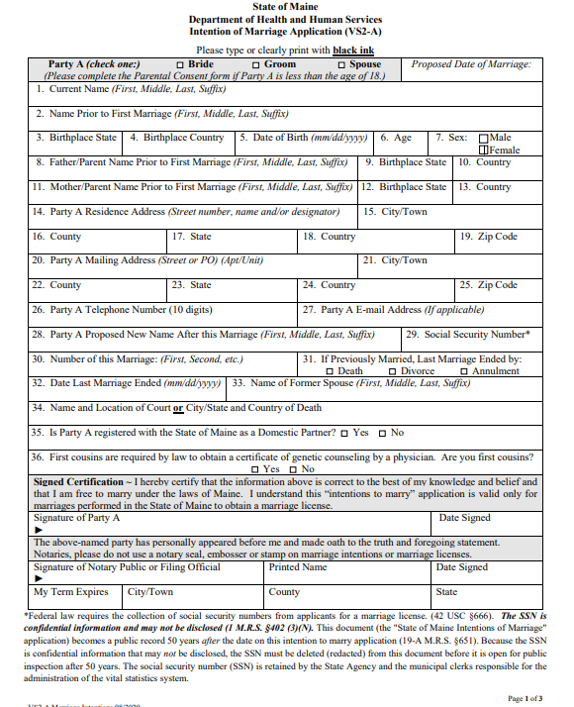
Marriage intention application marriage section, page 7
The marriage intention application (VS-2A) was revised in September of 2019 to include the party’s legal name after marriage. If a party intends to change that party's name upon marriage, the marriage intentions application must include the proposed new name of that party. Older versions of the marriage intention form should not be accepted. The marriage intentions form is three (3) pages; one page for each party along with instructions and requirements on the third page.
Notes:
Municipal clerks may obtain the marriage intention application under “Forms, Print Forms” in the Database Application for Vital Events (DAVE) system or on the Department’s website at https://www.maine.gov/dhhs/mecdc/public-health-systems/data-research/vital-records/forms/index.shtml.
If it is not convenient for either party to appear in person to file the marriage intentions, they may do so by mail and an official authorized to take oaths must witness their signatures. It is preferred that the completed marriage intentions be fully completed in black ink and contain no cross-outs although mistakes do happen. Municipal clerks may use their own discretion when accepting marriage intentions for filing. If the intentions have cross-outs the information must be legible. Once the marriage intentions have been accepted and filed, the Department recommends scanning and attaching them to the marriage case in the EMRS.

Slide 6
Required information on the marriage intentions marriage section, page 7
All the information on the “Intentions of Marriage” (VS-2A) concerning the parties must be complete. This includes their place of residence, date of birth, parental information, and their previous marital status. The party’s previous marital information is required; it is not optional. Middle names may remain blank although municipal clerks will have to check the override box in the EMRS and save the override button (located at the bottom of the screen). Identifying information on their parents’ names and birthplaces should be completed if known. The names of the parents may be biological or stepparent although it is highly recommended to match the party’s legal birth certificate. If a parent is not known, please type “Unknown”. If the party refuses to provide the parent(s) name(s), please type “N/A”. It is important to obtain parental information for genealogical purposes, as well as official uses of the marriage certificate for passports.

Slide 7
marriage intentions
The Sex/Gender field on the marriage intentions must indicate what the party’s driver’s license states. If a party wants to amend their gender/sex on their marriage certificate, they may apply for a correction by completing the VS-7 correction form and providing two pieces of documentation (driver’s license and birth certificate). Parties may also amend their first and middle name at this time to align with their gender identity. The party who is not amending their gender/sex on the marriage record must complete the personal affidavit section on the VS-7. A new VS-7 has been developed and will be implemented soon.
NEW
Notes:
Effective in October 2023.

Slide 8
marriage intentions continued marriage section, page 7
Both parties must complete their own page with their personal information and provide their social security numbers. The requirement of a social security number was eliminated from the State of Maine laws but is still required by federal law. Both parties must sign the certification statement in the presence of a notary or a municipal clerk (filing official).
Notes:
What if they don’t have a SSA number? Do you write the green card information here?

Slide 9
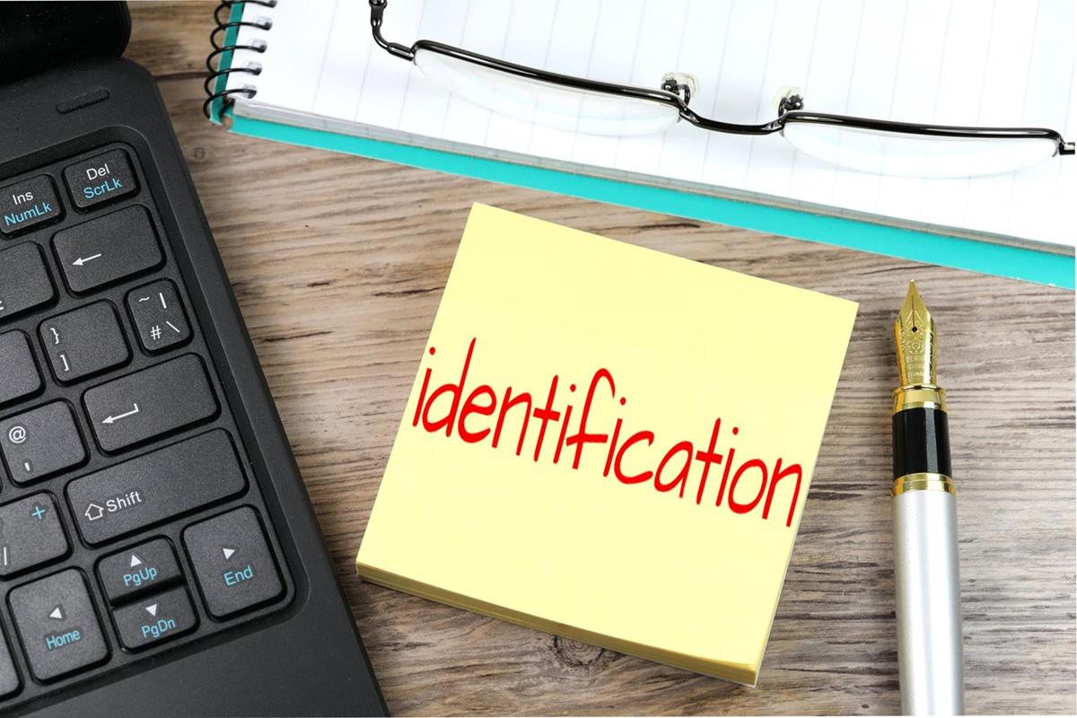
Identification marriage section, page 7
There is no requirement in Maine Law that parties must provide identification when filing the marriage intentions, unless the clerk or Department is not satisfied as to the identity of the applicants (or the clerk is acting as a notary public). To be consistent, municipal clerks may establish an office policy for this purpose. The policy may be made at the municipal clerk’s discretion.
Notes:
The exception to this is when a party’s gender has changed, and identification is needed to indicate the new gender on the marriage intentions.

Slide 10

Filing fee marriage section, page 7
The $40 fee for filing intentions of marriage must be paid at the time of filing and before the issuance of a marriage license. Municipal clerks have their own fee schedule set in statute.
Please visit the legislative website to view the municipal fee schedule at http://www.mainelegislature.org/legis/statutes/30-A/title30-Asec2652.html.
Notes:
Please remember to keep track of all marriage licenses issued from your municipality to report on the SSVR form. Clerks pay a $4.00 State fee for the any license issued by their municipality. As a reminder, the SSVR form (which is fillable), customer number, reporting period and instructions may be found in DAVE under the forms/print forms tab.

Slide 11
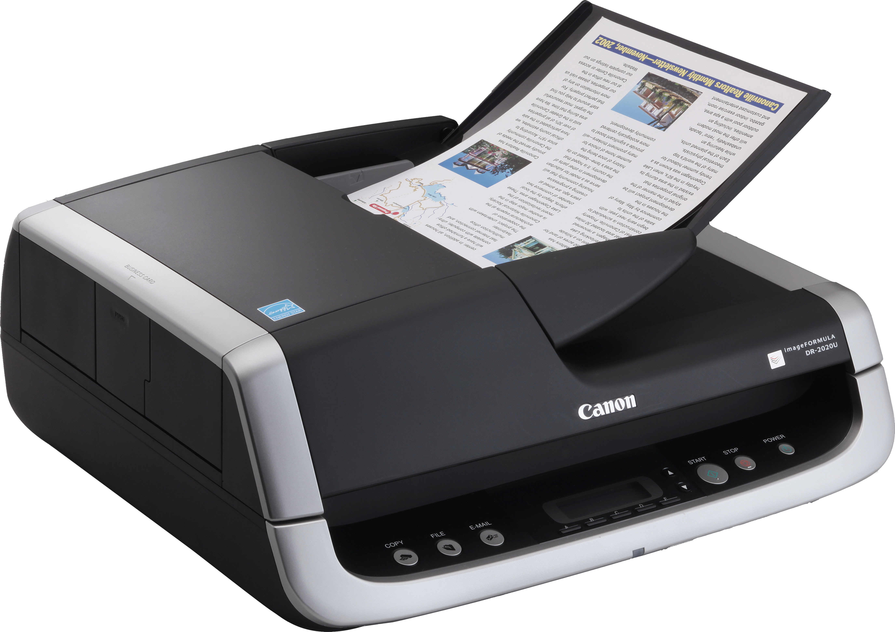
Retention of marriage intention application marriage section, page 8
The completed marriage intentions must be permanently maintained by the municipal clerk or the Department, whether maintained as paper or electronically.
The Department recommends scanning and attaching the completed intentions to the marriage case, once the case has been started.
Instructions for scanning and attaching documents in the DAVE system may be found on the Department’s website at https://www.maine.gov/dhhs/mecdc/public-health-systems/data-research/vital-records/edrs/medical-certifiers.html
This Photo by Unknown Author is licensed under CC BY-NC

Slide 12

Public Inspection marriage section, pages 8-9
The marriage intention application (VS-2A) is not open for public inspection for 50 years from the date of the application.
The names of the parties for whom intentions to marry are filed and the intended date of marriage are public records and open for public inspection. A non-confidential marriage form has been developed for this purpose. Municipal clerks may print a system-filled non-confidential form, by case, from the EMRS.
Instructions on how to print the non-confidential form from the EMRS may be found on page 8 & 9 in the marriage portion of the municipal clerk's handbook posted on DRVS website at https://www.maine.gov/dhhs/mecdc/public-health-systems/data-research/vital-records/edrs/medical-certifiers.html

Slide 13
who can file marriage intentions?
Anyone may file marriage intentions in the State of Maine, but a marriage license may only be issued if the parties demonstrate they are free to marry, are 18 years of age or older (unless consent is provided for 17 years old), are not related, and a caution to the marriage has not been filed.
Resident Defined
MARRIAGE SECTION, PAGE 10
A person is considered a resident of your municipality for purposes of marriage registration if:
The person is a registered voter in your municipality;
The person maintains a permanent household in your municipality;
The person usually lives in your municipality, but may be away part of the time (this does not include summer residents but can include military personnel);
The person has recently moved to your municipality and intends to make it their home.
Notes:
The residence of minors under the age of 18 years is assumed to be the residence of their parents or legal guardian(s). If the parents are divorced, it is assumed to be the residence of the parent having primary custody. If neither parent has sole legal custody, it is the residence of the parent with whom the minor usually resides. The residence of a minor who is emancipated is handled the same way as for any adult.
Members of the armed forces may claim residence in the State and municipality where they lived before entering the armed forces or in the municipality where their base is located. The same applies to students attending school in Maine who live in dormitories. Persons who are incarcerated in correctional facilities may claim residency where they are incarcerated; or where they were living before,they were incarcerated if they plan to return there upon their release from the correctional facility.

Slide 14
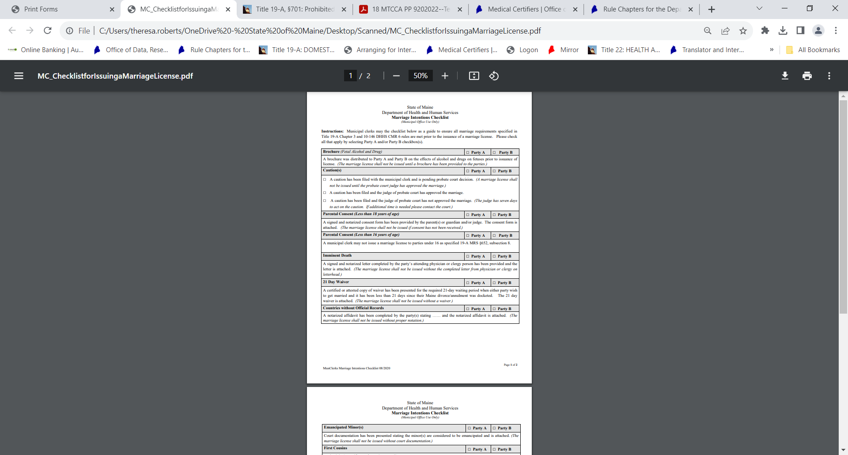
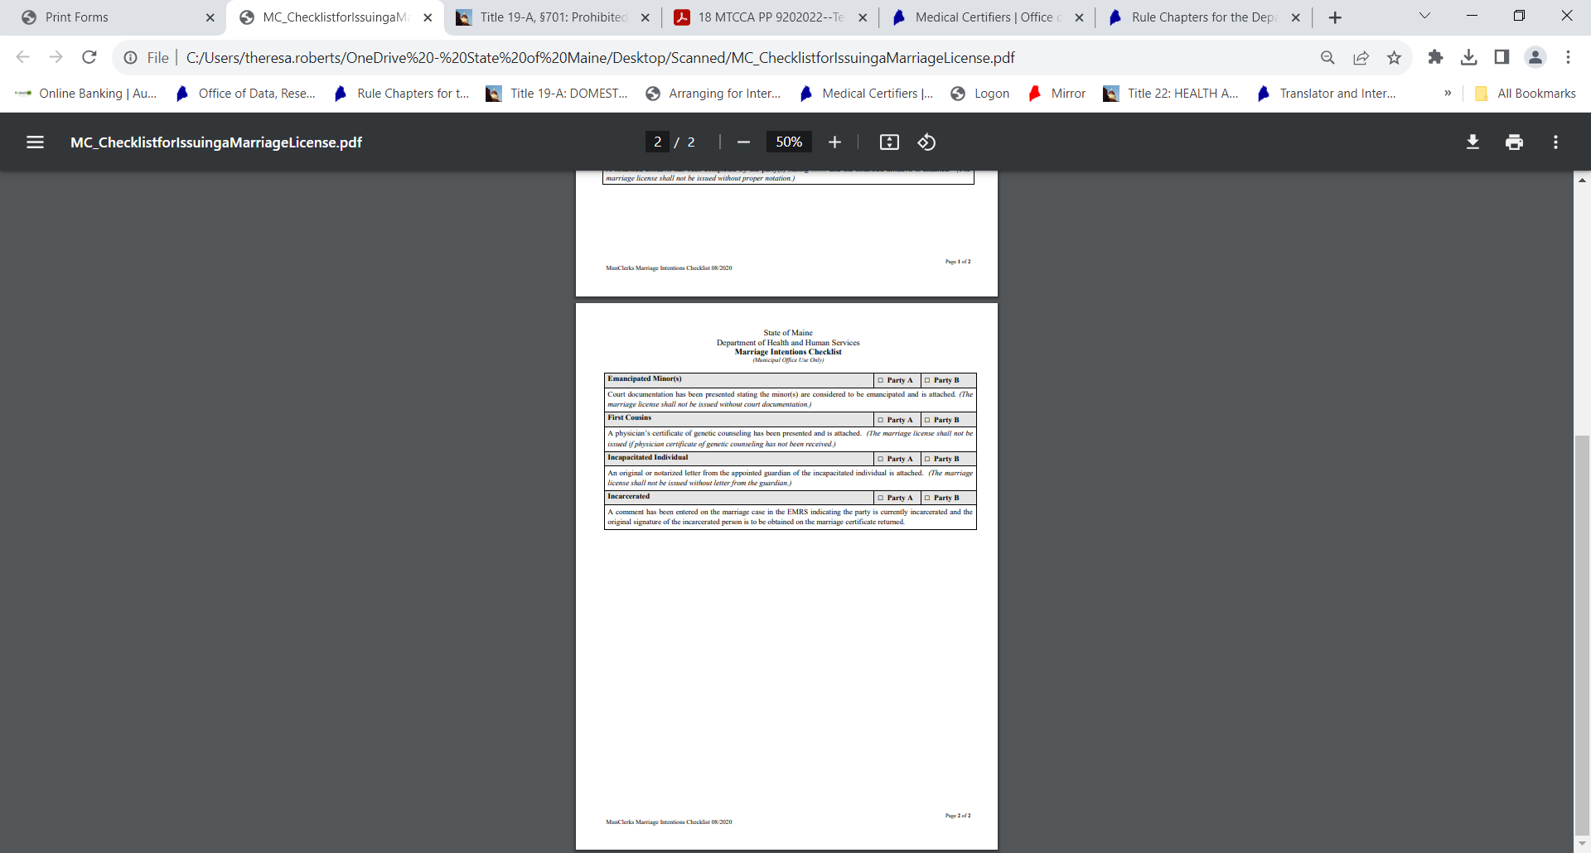
Municipal clerks' checklist
DAVE system
Notes:
The checklist may be found in the DAVE system under Forms/Print forms and informs clerks what to check for before issuing a marriage license as well as what documents are needed and retained.

Slide 15

Related Parties marriage section, page 11
Effective in September of 1987, if parties recording notice of their intentions to marry are related (first cousins), the parties must submit to the clerk or the Department, at the time of recording their intentions to marry, a certificate from a physician stating that the parties have received genetic counseling from the physician. The certificate or statement from the physician must be on facility letterhead and must be signed by the physician. Persons may not come to Maine to evade the laws of their own state to be married here.
Notes:
http://www.mainelegislature.org/legis/statutes/19-A/title19-Asec651.html Municipal clerks do not need to retain the certificate or statement. A comment may be entered on the marriage case stating the certificate or statement was presented prior to issuing the marriage license.

Slide 16

Prior marriages marriage section, page 11
There is no limit to the number of marriages allowed to individuals in the State of Maine.
Parties who have been previously married and plan to marry again, must provide the clerk or the Department with a certified copy of the death certificate, divorce decree, or annulment to demonstrate how the last marriage ended.
The clerk or the Department must ensure the information regarding how the last marriage ended on the marriage intentions match the certificate or certified copy of the death certificate, divorce decree or annulment presented. This includes the title and location of the courts, the names of the parties to the proceeding for the divorces or annulments and the date when the decrees became absolute.
In the case of a death of a former spouse, the clerk or the Department must show the name of the deceased along with the date and place of death.
Persons who reside and intend to continue to reside in a foreign country must present an affidavit stating that they are free to marry by the laws of the State in which they reside as well as under the laws of the State of Maine if their country does not have such documents.
Notes:
http://www.mainelegislature.org/legis/statutes/19-A/title19-Asec651.html

Slide 17
Prior marriages (continued) marriage section, page 11- 12
Death Certificate
Parties who have been widowed must present a certified copy of the death certificate pertaining to their most recent spouse.
All jurisdictions in the United States have the authority to issue certified copies of a death certificate for a person who passed away in their State. Certified copies of the death certificate are not required by the parties ONLY if the municipal clerk or the Department has the death certificate on file and can verify the validity of the certificate.
Most foreign countries do file and issue death records and foreign countries will provide certifications of deaths occurring within their boundaries. Persons who need a copy of a foreign death record should contact the Embassy or the nearest Consulate in the U.S. of the country in which the death occurred. Addresses and telephone numbers for these offices are listed in the U.S. Department of State Publication, Foreign Consular Offices in the United States, which is available in many local libraries. Copies of this publication may also be purchased from the U.S. Government Printing Office, Washington, DC 20402.
If the Embassy or Consulate is unable to provide assistance, U.S. citizens may obtain assistance by writing to the Office of Overseas Citizens Services, U.S. Department of State, Washington, DC 20520-4818. Aliens residing in the United States may be able to obtain assistance through the Embassy or Consulate of their country of nationality.
For more information, please visit the National Center for Health Statistics (NCHS) website at https://www.cdc.gov/nchs/w2w/foreign.htm.

Slide 18
Prior marriages (continued) marriage section, page 12
Maine Divorces
Because Maine law requires all courts in the State of Maine to file a record of each divorce judgment or annulment finalized in their jurisdiction within 45 days after judgment with the Department, a certified copy of the divorce is required to be presented to the clerk prior to any marriage license being issued.
The VS-4 Divorce Abstract form is furnished by the Department and made available to all Maine courts on DRVS restricted access website (courts only). The divorce abstract must contain the names and residences of the parties and name of the person to whom judgment was issued, the date and place of the marriage, the date of and legal grounds for the judgment and the names and ages of the minor children.
In Maine, there is a 21-day waiting period before a party to a Maine divorce may be remarried. The 21 days allows either party to the divorce the right to appeal the judge’s final decision. At the time of the divorce, the parties are given the option to sign a waiver of their right to appeal. If the parties choose to do this, the 21-day waiting period will not apply. If the parties apply for a marriage license and it has been less than 21 days since their MAINE divorce, they will need to produce a copy of the 3 day waiver that was signed at the time of their divorce before the license can be issued. Please note that the 21 days begins the date the divorce is DOCKETED. This may be a day or two LATER than the date the judge has signed the decree.
Notes:
Municipal clerks may verify any divorce that has occurred in the State of Maine with the Department, if needed, by completing the verification form and faxing the completed form to the Department at (207) 287-1093. Many jurisdictions are now starting to e-file divorces so they may appear different.

Slide 19
Prior marriages (continued) marriage section, pages 12-13
Out of State and Foreign Divorces
A record of divorce from another state or foreign country is evidence of divorce. If the record is not in English, the record must be translated into English by a disinterested 3rd person at the parties' expense. Not all states use a raised seal when certifying or attesting a record of divorce. If you are presented with a divorce decree or certificate that does not have a raised seal, it MUST have an original stamp or signature from either a Judge or Clerk of Courts. This means that if a seal is present, it must not be a photocopy of a document with a seal.
Copies of foreign divorce certificates may be obtained directly from the civil registrar or court in the foreign country where the marriage or divorce occurred although they may not always be certified. Contact the embassy or consulate of the foreign country in the United States for guidance on how to obtain copies of foreign public documents. Foreign embassies may require written requests in their language.
Notes:
http://www.mainelegislature.org/legis/statutes/19-A/title19-Asec651.html

Slide 20

Prior marriages (continued) marriage section, page 13
Annulled Marriages
Parties who have had a previous marriage annulled must present a copy of the court annulment. The annulment completely dissolves the marriage as though it never occurred. This means that if a party to an annulment goes through another ceremony at a later date, the ceremony following an annulment would be considered the 1st marriage (or appropriate corresponding number following a marriage that was NOT annulled) since the annulled marriage is considered to have never occurred. Marriages annulled through a church MUST still be annulled through a court of law.
This Photo by Unknown Author is licensed under CC BY-ND

Slide 21

Parental consent marriage section, page 13
Marriages of Minors Under 16
http://www.mainelegislature.org/legis/statutes/19-A/title19-Asec652.html
The municipal clerk or the Department may NOT issue a marriage license to minors 16 and under. It is not permitted in the State of Maine.
Marriages of Minors Under 18 (Consent required)
http://www.mainelegislature.org/legis/statutes/19-A/title19-Asec652.html
Parties the age of 17 who plan to get married in the State of Maine must obtain the written consent of their parents or legal guardians. If they have no living parents and no legal guardian, they must apply to the judge of probate in the county where they reside (unless they are emancipated by a court).
Notes:
LD 443, An Act to Prohibit Marriage of Any Person Under 17 Years of Age.
The language in the revised law will prevent parties under the age of 17 from getting married in the State of Maine. Parties who are 17 years of age and wish to be married must obtain written consent from their parents, guardians, or the person to whom a court has given custody effective October 25, 2023.

Slide 22
Marriages of minors marriage section, pages 13 -14
Parents
Both parents must give consent to the marriage if they are both living and have joint custody. If a parent who has custody fails to consent, the marriage may not take place. If one parent has sole custody under a court judgment, then only the consent of that parent is required. (The parent without custody may give consent as a matter of courtesy, but it is not required by law.) When the whereabouts of a parent having custody is unknown, the party may be referred to the Probate Court who may rule on the custody of the party for the purpose of the marriage or otherwise give consent.
Legal Guardian
It is not necessary for the party to obtain the written consent of the parent(s) if the party has been appointed a legal guardian. If a party has been appointed a legal guardian by a court of competent jurisdiction, the guardian must provide the consent to the intended marriage.
Judge of Probate
If there is no parent or legal guardian who can provide consent to the marriage, the minor must apply to the probate court to obtain the written consent. The judge of probate in the county where each minor resides may grant consent after notice and opportunity for hearing.
Emancipated Minor
Marriages of emancipated minors are treated as if the child is an adult of 18 years or older. Municipal clerks must be presented with the court document in order to ascertain the minor’s legal status prior to issuing a marriage license. The court document must be scanned and attached to the marriage case in the EMRS.

Slide 23
Consent form marriage section, page 14
The “Notice of Parental/Guardian Consent to a Marriage” form and instructions is located in DAVE under forms, print forms to municipal clerks and is also located on the Department’s website to the general public at https://www.maine.gov/dhhs/mecdc/public-health-systems/data-research/vital-records/forms/index.shtml under Marriage Forms and Information.
The parent(s) or court appointed guardian must complete and sign the consent form as specified in the paragraphs above and present the completed form to the municipal clerk or Department who is issuing the marriage license. The consent form must be signed in the presence of a municipal clerk or notary public and must be scanned and attached to the marriage case in the EMRS.
If minors go through with a marriage without appropriate consent, the marriage is “voidable”; that is, a parent or guardian may request to have the marriage annulled. However, if the parent or guardian elects to take no action, the marriage is valid.

Slide 24

Intoxicated Parties
Municipal clerks may use their discretion before issuing a marriage license to intoxicated parties. Because the law does not prohibit intoxicated parties from filing their marriage intentions, it is suggested that the municipal clerk adopt an office policy for the parties to pick up their marriage license at a later date.

Slide 25
Quaker: Baha’i/self solemnization marriage section, page 21
A marriage solemnized among Quakers or Friends, in the form practiced in their meeting, or solemnized among members of the Baha'i faith according to the rules and principles of the Baha'i faith, is valid. The clerk or the keeper of the records of the meeting or ceremony in which a marriage is solemnized shall return evidence of the solemnization of the marriage to the Department. A person who willfully neglects or refuses to perform the duty imposed upon that person by this section commits a civil violation for which a forfeiture not to exceed $100 for each offense may be adjudged for the use of the municipality in which the offense occurred.

Slide 26

Filing a caution marriage section, pages 10-11
Anyone who believes that persons may be attempting a prohibited marriage may file a “caution” by notifying the municipal clerk or the Department that may be issuing the marriage license. The filing of a caution prevents the issuance of a marriage license until the matter is resolved by a court hearing.
Since Maine no longer has a three (3) day waiting period, there may be several occasions when a marriage license has already been issued and the caution may no longer be filed to prevent the marriage.
Notes:
Cautions must not be used to harass persons legitimately attempting marriage and persons filing cautions for insufficient reasons will be held responsible for costs of court hearings. Inform anyone attempting to file a caution that the judge can prevent the marriage only if the persons are forbidden to marry or are incapable of contracting marriage under the law. One example of this would be when either party has been appointed as a legal guardian through a court or for an individual that is incapacitated. Before we move to the next slide about the requirements of filing a caution, we are curious to know if any municipalities with us today have received a caution in their municipality. Please raise your hand if you have ever filed a caution or received a caution in your municipality. Is there anyone interested in sharing their experience?

Slide 27
Filing a caution (continued) marriage section, pages 10-11
The person filing the caution is responsible for obtaining a ruling from the Judge of Probate in the county where the parties reside within 7 days after the caution is filed. The judge may request an extension if more time is needed. The marriage license may not be issued until the judge issues a ruling or the 7 days have passed with no word from the Judge of Probate. If the person filing the caution fails to seek the ruling or withdraws the caution, the license may not be withheld longer than 7 days.
Cautions must be written, must clearly identify the parties involved, and must plainly state the reason why the parties cannot marry, and must be signed and acknowledged under oath by the person entering the caution. If it is the municipal clerk who wishes to file a caution, the caution may be photocopied onto Municipal letterhead.
If it is a person other than a municipal clerk who wishes to file a caution, then photocopy the caution onto plain paper and take the cautions from the person wishing to file. Make sure to get appropriate signatures.
Notes:
When a caution is filed with the Department, a new case will be started in the EMRS and put on hold with a comment and the status of the caution. This will prevent any municipality from issuing a marriage license since they will see the names in the search results when start/editing a new case in the EMRS. It is highly recommended that clerks do the same if a caution is received in their municipality. DRVS will also notify clerks via e-mail.
http://www.mainelegislature.org/legis/statutes/19-A/title19-Asec653.html

Slide 28

incarcerated persons marriage section, page 16
If either of the parties is incarcerated in a State correctional facility, the license may be issued without the incarcerated person’s signature. The party to the marriage that is NOT incarcerated should obtain the VS-2A (intentions of marriage) and bring it to the correctional facility to be completed by the incarcerated person in the presence of a notary public. Once the incarcerated person has completed their information and had their signature notarized on the marriage intentions, the marriage intentions may be filed (municipality of residence of either party or the Department).
The municipal clerk of the municipality where intentions are filed may issue a marriage license (VS-2B) without the signature of the party who is incarcerated upon the approval of the correctional facility.
The municipal clerk or the Department must issue the marriage license from the EMRS and enter a comment on the marriage case indicating the party is currently incarcerated and the original signature of the incarcerated person is to be obtained on the marriage certificate returned.
Notes:
The residence of a person incarcerated in a correctional facility, as defined in Title 34-A, section 1001, or in a county jail does not include the municipality where a person is incarcerated unless the person had resided in that municipality prior to incarceration. A person incarcerated in a correctional facility may apply for a marriage license (or register to vote) in any municipality where that person has previously established a fixed and principal home to which the person intends to return.
The person performing the ceremony must make certain that the incarcerated person signs the license at the time of the ceremony in their presence.
After the ceremony has taken place and the municipal clerk or the Department has received the completed and endorsed marriage license back from the officiant, the marriage section may be completed in the EMRS in the usual manner.

Slide 29
Imminent Death marriage section, page 17
In extraordinary or emergency cases when the death of either party is imminent, the party to the marriage that is NOT the patient should obtain the VS-2A (intentions of marriage) and bring it to the hospital to be completed by the patient in the presence of a notary public. Once the patient has completed their information and had their signature notarized on the marriage intentions, the marriage intentions may be filed (municipality of residence of either party or the Department).
The municipal clerk of the municipality where intentions are filed may issue a marriage license (VS-2B) without the signature of the party who is hospitalized (or otherwise incapacitated) upon the authoritative request of a minister, clergy, priest, rabbi or attending physician. The municipal clerk or the Department must first see the authorization from one of the above-mentioned persons on letterhead before the marriage license is released.
The letter that is presented to the municipal clerk or the Department must state the following:
That (Name of patient) is in the hospital and cannot come to the municipal office.
The patient’s death is imminent.
The patient is conscious and coherent; and
The patient has made it known that it is their wish to be married.
The municipal clerk or the Department must issue the marriage license from the EMRS and retain the physician or clergyman’s authorization by scanning and attaching to the marriage case. It is also recommended to enter a comment on the case that death is imminent.
Notes:
The person performing the ceremony must make certain that the patient (whose death is imminent) signs the license at the time of the ceremony in their presence.
After the ceremony has taken place and the municipal clerk or the Department has received the completed and endorsed marriage license back from the officiant, the marriage section may be completed in the EMRS in the usual manner.
During this type of situation, if any questions arise, please contact the Department for assistance at (207) 287-6490 or (207) 287-3771.

Slide 30

Certification Statement on Marriage License marriage section, page 19
The certification statement must be signed by both parties in the presence of the issuing official (municipal clerk or Department). Parties may appear at different time to sign the marriage license if needed. It is highly recommended to read the certification statement to the parties. A marriage contracted when either party has failed to submit a certificate of certified copy of the divorce decree or annulment of the last marriage or the death record of the last spouse or when either party has intentionally been untruthful about the number of previous marriages is void.
Notes:
Recent legislation now allows for the officiant to obtain the signatures on the marriage license in the event the clerk is unable to issue the license to the parties in person; mostly as a result of Covid. The Fetal Alcohol and Drug Brochure must be presented to the parties at the time the license is issued. The brochure may be found on the DRVS public forms page under the Marriage Forms & Information section at https://www.maine.gov/dhhs/mecdc/public-health-systems/data-research/vital-records/forms/index.shtml.

Slide 31
Marriage license marriage section, page 14
A valid Maine marriage license is required for a marriage to be solemnized in Maine. Marriage licenses are valid for 90 days from the day the intentions were filed, and parties may be married in any city/town or unorganized township in the State of Maine. Parties may not take the marriage license out of the State of Maine to be married nor use a marriage license issued by another State to be married in the State of Maine. In the event the 90 days have past, parties must obtain another marriage license, provide the same documentation requirements, and pay the $40.00 fee.
Brochure. A marriage license may not be issued until a brochure prepared by the Department of Health and Human Services concerning the effects of alcohol and drugs on fetuses has been given to both parties. The department is responsible for making the brochures available to municipal clerks for distribution.
The brochure may be found on the Department’s website under “marriage forms and information” at https://www.maine.gov/dhhs/mecdc/public-health-systems/data-research/vitalrecords/forms/index.shtml.
Notes:
There may be times when parties are married in Maine without obtaining their marriage license. In tomorrow’s training we will discuss more in depth along with the different scenarios.

Slide 32
Marriage license (continued) marriage section, page 14
The marriage license was revised in June of 2019 to include the parties legal name(s) after marriage. If a party intends to change their name(s) upon marriage, the marriage intentions application must include the proposed new name of that party. Older versions of the marriage license must not be issued. The marriage license is one page and should be issued from the EMRS. Once the municipal clerk or the Department have accepted the marriage intentions for filing, they can start a new case in the EMRS based on the information provided by the parties on the marriage intentions to create and issue the marriage license.
In the event the EMRS is not available, or circumstances prevent electronic filing and/or issuance, municipal clerks may contact the Department directly at (207) 287-3771 to obtain a blank marriage license (VS-2B). It is recommended to have some paper licenses on hand. The marriage license form (VS-2B) is printed on white legal-size (8.5 X 11) regular photocopy (20 LB) and is prepared by the Department or municipal clerk based on the information the parties provided on the marriage intentions. The fillable blank form is also available in DAVE under forms/print forms.
Notes:
Please be sure to always have the parties proofread a copy of the marriage license before affirming/signing as the issuing official on the marriage license in the EMRS. This can be done by printing a marriage license working copy from the EMRS.

Slide 33
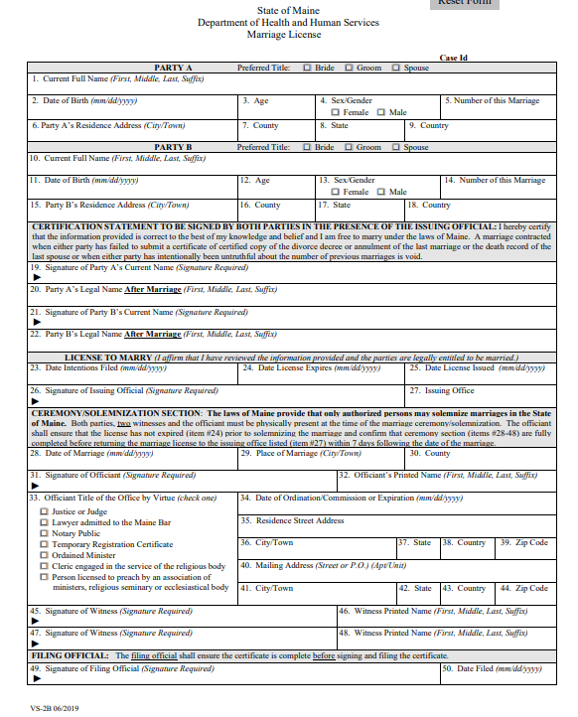
Marriage license (continued) marriage section, page 15
The marriage license must match the information exactly as shown on the marriage intention application whether issued from the EMRS or as paper based.
When preparing the marriage license be sure to calculate the 90 days carefully before entering the license expiration date in the block labeled “License valid until”. The 90-days will be automatically calculated when issued from the EMRS.
Notes:
As stated in the last slide, it is highly recommended to always have the parties proofread a copy of the marriage license before affirming/signing as the issuing official on the marriage license in the EMRS. This can be done by printing a marriage license working copy from the EMRS. Instructions on how to print the marriage license working copy may be found on page 15 in the marriage portion of the municipal clerk’s handbook posted on DRVS website for clerks at https://www.maine.gov/dhhs/mecdc/public-health-systems/data-research/vital-records/edrs/medical-certifiers.html. We will also do a quick demonstration in tomorrow’s class.

Slide 34
Errors on marriage license
If any errors are caught, they may be corrected prior to entering the information into the EMRS and up until the point the marriage license has been issued.
When the parties notice an error on the working copy of the marriage license and the municipal clerk has not yet affirmed the license, they may initial the incorrect information on the working copy of the marriage license and the municipal clerk may enter a comment in the EMRS in support of the error. Please be sure to scan the working copy to the marriage case with party’s initials.
There may be occasions that once the clerk has already affirmed the license (but has not yet issued it) and items need to be corrected. Municipal clerks may “un-affirm” the license by selecting the “Approve License” link again and select the “un-affirm” button and make the necessary changes. Same as the above, please be sure to enter a comment and scan the working copy to the marriage case with the party’s initials.
Notes:
Once the marriage license has been issued, no corrections may be made until the marriage certificate has been registered. Please remember, municipal clerks and parties only have 90 days from the date the marriage record was filed (assigned a State File Number) to submit a correction without providing two (2) pieces of supporting documentation and the required fee. See page 26 on how to submit an electronic correction/amendment within 90 days.

Slide 35
Officiant Responsibility marriage section, page 20
Before beginning the marriage ceremony, the officiant is responsible for examining the marriage license carefully to ensure that it has been signed by both parties. The officiant must also verify that the license has not expired (item #24) and the municipal clerk who issued the marriage license has signed the license with an original or electronic signature. (This would also be the time to capture the signature of a party who is incarcerated or who’s death is imminent.)
Both parties, two witnesses and the officiant must be physically present at the time of the marriage ceremony/solemnization. The officiant must complete the ceremony section (items #28-48) after the marriage ceremony/solemnization has been performed and return the marriage license to the issuing office (item #27) within 7 days following the date of the marriage. This may be done in person or through the mail. Black ink is preferred, but not required if the license is legible.
Notes:
Maine law requires that persons solemnizing a marriage keep a record of each marriage performed. It is suggested that officiants maintain a book or file for all marriages they have performed. The marriage license may be photocopied for this purpose, but copies should never be issued to anyone.

Slide 36
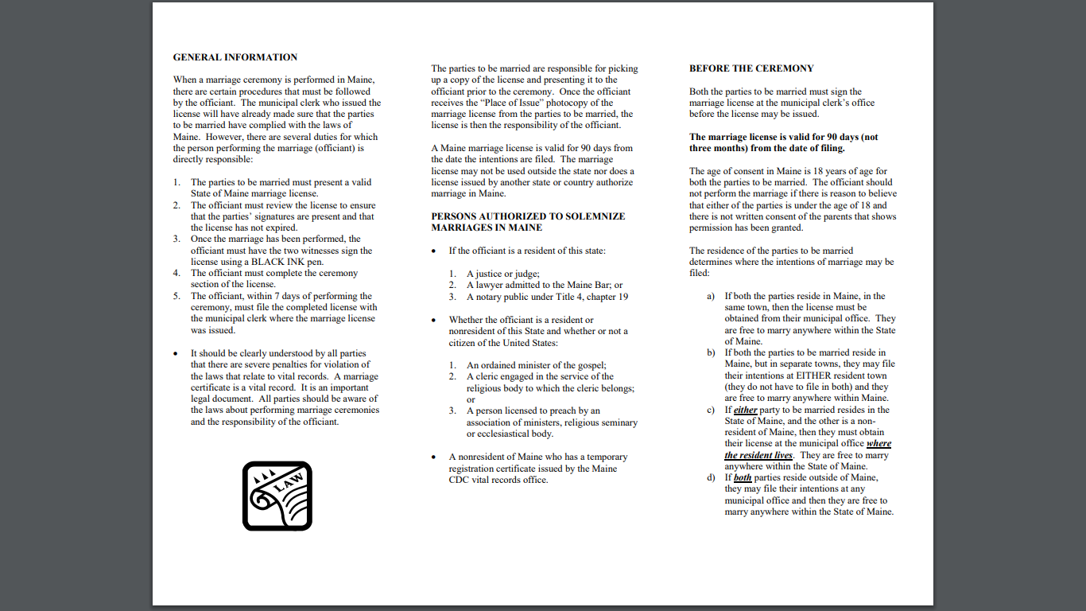
Performing a Marriage Ceremony pamphlet
A pamphlet on performing a marriage ceremony in Maine may be found on the Department’s website to assist officiants with current procedures and instructions https://www.maine.gov/dhhs/mecdc/public-health-systems/data-research/vital-records/forms/index.shtml.
Municipal clerks may print and distribute to the parties to provide to the officiant at the time the marriage license is issued.

Slide 37
Authorization to Perform Marriages in Maine marriage section, page 20
The laws of Maine provide that only authorized persons may solemnize marriages in the State of Maine.
The following may solemnize marriages in this State:
If a resident of this State:
A justice or judge.
A lawyer admitted to the Maine Bar; or
A marriage officiant under Title 5, section 90-G; NEW July 1, 2023
Whether a resident or nonresident of this State and whether or not a citizen of the United States:
An ordained minister of the gospel; (including internet ordained)
A cleric engaged in the service of the religious body to which the cleric belongs; or
A person licensed to preach by an association of ministers, religious seminary or ecclesiastical body.
A nonresident of the State who has a temporary registration certificate issued by the Office of Data, Research and Vital Statistics.
Notes:
http://www.mainelegislature.org/legis/statutes/19-A/title19-Asec655.html

Slide 38
Issuing the marriage license from emrs
Live Demo from Rebecca Ashley
https://gatewaytest.state.me.us/EVRS_MIRROR_WEB/Logon.aspx
Notes:
Written instructions on how to issue the marriage license form the EDRS are available on page 17-19 in the marriage portion of the municipal clerk's handbook located on DRVS website for clerks at https://www.maine.gov/dhhs/mecdc/public-health-systems/data-research/vital-records/edrs/medical-certifiers.html. Discuss paper process here.

Slide 39

BREAK time

Slide 40
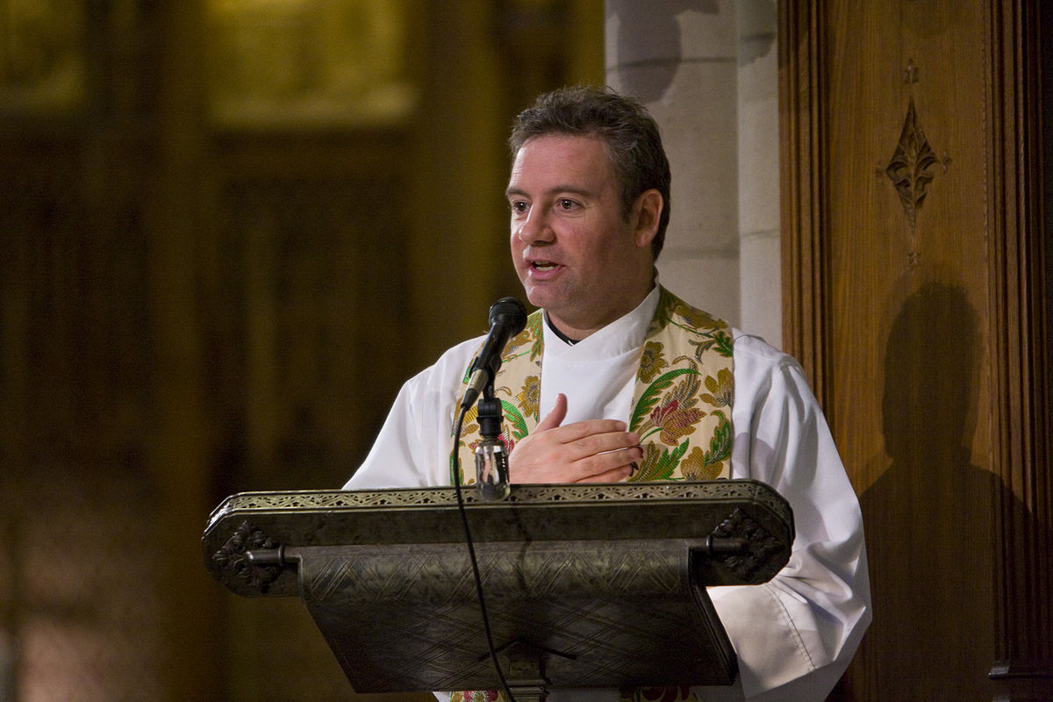
Marriage License Returned from the Officiant marriage section, page 23
Examine the CEREMONY section when a marriage license is returned to you for filing to be sure that the section is properly completed and all required signatures are present, including those of the two witnesses. Contact the officiant directly if any information is missing or improperly recorded. If you do not receive a response within 21 days, report the matter to Vital Records for further action.
When you are satisfied that everything is in order, accept the license for filing by signing the license as the registrar and enter the date of filing. Then, complete the Marriage-Officiant and Filing Official section in DAVE within 7 days* after you receive it (“7 days” excludes the day on which the time period begins. It includes weekends and holidays unless the 7th day falls on a weekend or holiday; in that case, the period ends on the next day, which is not a weekend or holiday).

Slide 41
Entering the Completed Marriage License in the EMRS
Live Demo from Rebecca Ashley
https://gatewaytest.state.me.us/EVRS_MIRROR_WEB/Logon.aspx
Notes:
Written instruction may be found on pages 23-24 in the marriage portion of the municipal clerk's handbook posted on DRVS website for clerks.

Slide 42

Marriage License Not Returned after 90 Days marriage section, page 24
If 90 days from the date of issue has passed and the officiant has not returned the license, it is recommended that the municipal clerk or the Department who issued the marriage license send a registered letter to the parties and the officiant (if known) at the address provided on the marriage intentions. The letter should state that a license has not been returned and to contact the municipal clerk or the Department who issued the license within 15 business days. If contact is not made within that time frame, the municipal clerk or the Department must enter a comment on the marriage case in the EMRS of the date the letter was sent to the parties and officiant with no response.

Slide 43

Correcting a Certificate of Marriage marriage section, pages 24-25
When a person wishes to file an application (VS-7) to correct a certificate of marriage, they must submit the application directly to the Department. The application and instructions to correct a vital record may be found on the Department’s website at https://www.maine.gov/dhhs/mecdc/public-health-systems/data-research/vital-records/forms/index.shtml under the vital records requests and information.
Who may apply for the correction?
Only the Officiant may apply to correct errors in the ceremony section. The application to correct or complete a vital record (VS-7) must be completed as paper-based.
The Parties may apply to correct personal data on themselves. The application to correct or complete a vital record (VS-7) must be completed as paper-based.
The Municipal Clerk may apply to correct clerical errors made in the municipal clerk’s office. The application to correct or complete a vital record (VS-7) must be completed electronically. See directions on how to submit an electronic amendment on page 27.
Notes:
The process for correcting a marriage record that is under 90 days old from the date the marriage was registered (filed) differs from the process for correcting a marriage record greater than 90 days from the date the marriage was registered (filed).
If there are questions regarding the correction process, the applicant may contact a staff member by calling the toll-free number of 1-888-664-9491 x4 or (207) 287-6490.

Slide 44

Correcting a Marriage within 90 days by parties or officiant marriage section, page 24
Parties or the officiant may apply to correct or complete a marriage record within 90 days from the date the record was filed by completing a paper-based application for correcting or completing a marriage record.
The front side of the VS-7 must be completed by the applicant(s) and their signature(s) must be notarized. The application should have both the parties full name(s) as it appears on the record. The incorrect information, along with the item numbers where the error is located, must be printed in the box(es) on the left. The correct information must be printed in the box(es) on the right.
There is no fee to correct a record within 90 days old. If the applicant(s) would like to obtain a certified copy of the corrected record, a $15.00 fee does apply. Additional copies may be requested at the time of correction, for $6.00.

Slide 45
Correcting a Marriage Record after 90 Days marriage section, page 25
Parties or the officiant may apply to correct or complete a marriage record after 90 days from the date the record was filed by completing a paper-based application for correcting or completing a marriage record, providing two (2) pieces of supporting documentation (see examples below) and the required fee.
The front side of the VS-7 must be completed by the applicant(s) and their signature(s) must be notarized. The application should have both the parties full name(s) as it appears on the record. The incorrect information, along with the item numbers where the error is located, must be printed in the box(es) on the left. The correct information must be printed in the box(es) on the right.
There is a $60.00 fee to correct a record after 90 days from the date the record was filed and includes a certified copy of the corrected record. Additional copies may be requested at the time of correction, for $6.00.
All documentation used as evidence to support a correction must be original, certified or attested copies. Documents provided by the applicants will be returned once the correction or completion has been made.

Slide 46

Correcting Clerical Errors made by the Municipal Clerk marriage section, pages 26-27
It is the responsibility of the parties to double-check their marriage license when they pick it up. If the marriage license is not reviewed and a clerical error is discovered 90 days after the marriage record was filed, the parties (or the officiant) must apply to make the correction as described above.
If the clerical error was discovered within 90 days from the date the marriage record was filed, the municipal clerk who issued the marriage license may submit an electronic correction to the marriage case in the EMRS.
Notes:
Instructions on how to submit an electronic correction may be found on page 26 & 27 of the marriage portion of the municipal clerk's handbook on DRVS website for clerks at https://www.maine.gov/dhhs/mecdc/public-health-systems/data-research/vital-records/edrs/medical-certifiers.html. If time permits do a live demo.

Slide 47
Temporary Registration Certificate (non-residents) marriage section, pages 20-21
Non-residents who are authorized to solemnize marriages in another State may solemnize a single marriage ceremony in Maine for a specific couple after securing a temporary registration certificate from the Department. The officiant application may be found on the Department’s website under marriage forms and information at https://www.maine.gov/dhhs/mecdc/public-health-systems/data-research/vital-records/forms/index.shtml.
Non-residents who obtain an “Out of State Non-Resident Officiant Certificate of Solemnization” from the Department may perform a single marriage ceremony for the couple named on the certificate within 90 days of issuance. The Certificate of Solemnization will be scanned and attached to the marriage case in the EMRS by the Department once the case has been started by the municipal clerk (or the Department).
Notes:
The Department will track the issuance of all Certificates of Solemnization and compare the names on marriage certificates to ensure compliance.

Slide 48

Validity of Marriages marriage section, page 21
The Laws of Maine protect the integrity of marriages against errors, oversights, and deceit. When two individuals who obtain a marriage license and go through a ceremony before a person whom they believe to have the power to marry them and consummate the marriage in good faith on the part of either of the persons married, it is a lawful marriage unless it is otherwise void under the law.
A marriage, solemnized before any known inhabitant of the State professing to be a justice, judge, notary public or an ordained or licensed minister of the gospel, is not void, nor is its validity affected by any want of jurisdiction or authority in the justice, judge, notary or minister or by any omission or informality in entering the intention of marriage, if the marriage is in other respects lawful and consummated with a full belief, on the part of either of the persons married, that they are lawfully married.
Notes:
Provide scenarios and open up for discussion.

Slide 49
Prohibited (Void) Marriages marriage section, pages 22 -23
Certain marriages are prohibited by law in Maine. If performed, such marriages are considered void.
Any marriage performed in another state that would violate any provisions of Maine Law if performed in this State is not recognized in this State and is considered void if the parties take up residence in this State.
Marriages of persons with their own parents, grandparents, children, grandchildren, brothers or sisters, aunts or uncles, and nieces or nephews are forbidden and are void. Marriages of first cousins are permitted in certain circumstances if a physician's certificate of genetic counseling is presented.
A person for whom a guardian or limited guardian has been appointed under Title 18-C, section 5-301 may not contract marriage without the approval of the appointed guardian. For persons under limited guardianship, the court must grant the specific power to contract for marriage to the guardian.
If minors under the age of 18 go through a marriage without appropriate consent, the marriage is “voidable”. The parent or guardian may request to have the marriage annulled. If the parent or guardian does not initiate such action, the marriage is valid.
A marriage contracted while either party has a living spouse from whom the party is not divorced is void.
A marriage contracted when either party has failed to submit a certificate or certified copy of the divorce decree or annulment of the last marriage or the death record of the last spouse or when either party has intentionally lied about the number of previous marriages is void.
Notes:
Municipal clerks need not review personal backgrounds to ensure parties are not attempting to enter into a void marriage. However, if you have reason to believe that this may be the case, the filing of a caution will prevent the issuance of a marriage license until a court can make a ruling. Cautions are described on page 11.
If the parties go through with a marriage and one of the above conditions exists, the marriage may be voided. The Department will verify whether or not the marriage is void and will take the steps necessary to void all records of the marriage.

Slide 50
Single Status Letters

Slide 51
Apostille seal
(secretary of state’s office)
Notes:
An apostille is a form of authentication appropriate to countries that have consented to be bound by the 1961 Hague Convention Abolishing the Requirement of Legalization for Foreign Public Documents. They are often needed in adoptions, extraditions, and certain business transactions. For more information on countries party to or bound to this convention, please visit the Hague Conference website, Apostille Section.

Slide 52





Questions?

Slide 53


